Slide 1

Mobile sensors support in ios
ABDALLAH MAHMOUD
MOUHAB MAHMOUD
OMAR OSAMA

Slide 2

AGENDA
Introduction
Proximity Sensor
Accelerometer
Ambient Light Sensor
Moisture Sensor
Gyroscope
Compass
Barometer
Touch ID
Face ID
Hardware Sensors

Slide 3
Introduction
The iPhone, iPad, and iPod touch are able to perform some of their coolest interface tricks — from dimming a phone screen when it's held up to your head to undoing an action by shaking the device and beyond — thanks to the sensors built into most models of those devices. Without these sensors, none of the devices would be what we know them as today.
Not every model of the iPhone, iPad, or iPod touch has the exact same set of sensors, and the capabilities the sensors enable on each model has as much to do with the operating system being used as the hardware itself.

Slide 4
PROXIMITY SENSOR
This sensor determines how close the iPhone is to your face. It's what helps the iPhone turn off its screen automatically whenever you hold the phone up to your ear for a phone call. This feature is necessary to prevent accidental button taps on the side of your head when talking.

Slide 5
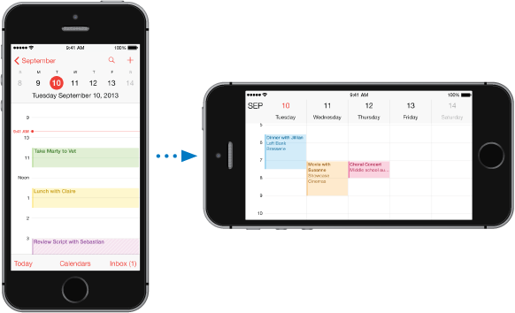
Accelerometer
This sensor enables the iPod touch, iPad, or iPhone’s screen to automatically switch from landscape to portrait modes and back again based on whether you’re holding the phone vertically or horizontally.
A basic functional principle to a motion sensor involves the transformation of the detection of a motion into an electrical current. Detection of motion is achieved by measuring optical change in the target field of view.

Slide 6
Ambient light sensor
A typical ambient light sensor detects the intensity of light surrounding the iPhone and processes this information to help adapt the phone light accordingly. Adjustment to the brightness of the iPhone screen is a conventional method to help conserve as much battery life as possible. Ambient light sensors work by blocking or filtering the infrared and ultraviolet wavelengths.

Slide 7
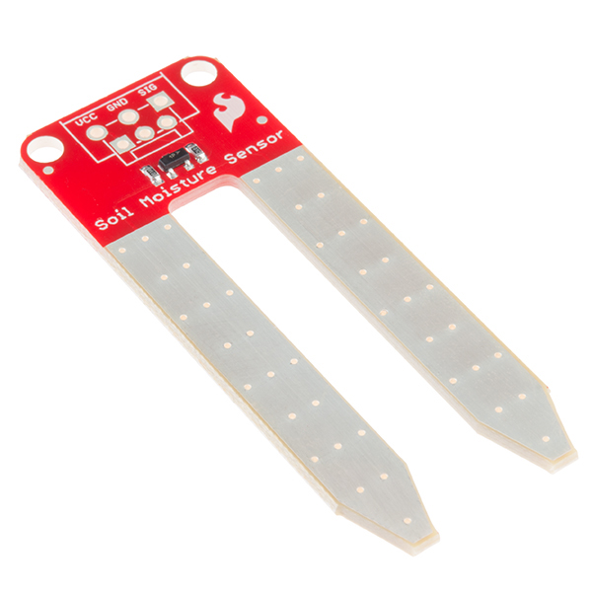
MOISTURE SENSOR
The moisture (or water) sensor is a little red tab that appears in the Dock Connector after the phone has been submerged in water. It can also appear as a red dot in the headphone jack, depending on the model. If you're buying a used iPhone, it's a good idea to check for this indicator to make sure the device hasn't been damaged by water.

Slide 8
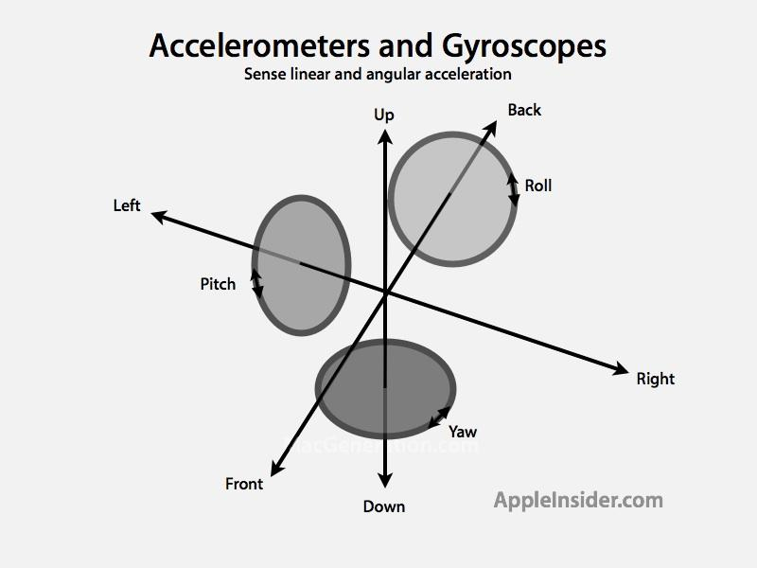
GYROSCOPE
Starting with the iPhone 4, 4th Gen. iPod touch, and iPad 2 there's another sensor: a three-axis gyroscope. When combining the gyroscope with the accelerometer, this combo gives these devices six axes on which it can operate. This is designed to make the devices more sensitive, responsive and powerful for gaming, allowing them to react based on how the devices are held and moved.

Slide 9

COMPASS
This sensor is used with the device's GPS and other location awareness features to help determine your iPhone's location, which direction it's facing, and to get you where you're going.

Slide 10

BAROMETER
Barometers assess air pressure to help, in part, to determine altitude. This sensor is used for location and directions features: It can help determine the more precise location of your device.

Slide 11
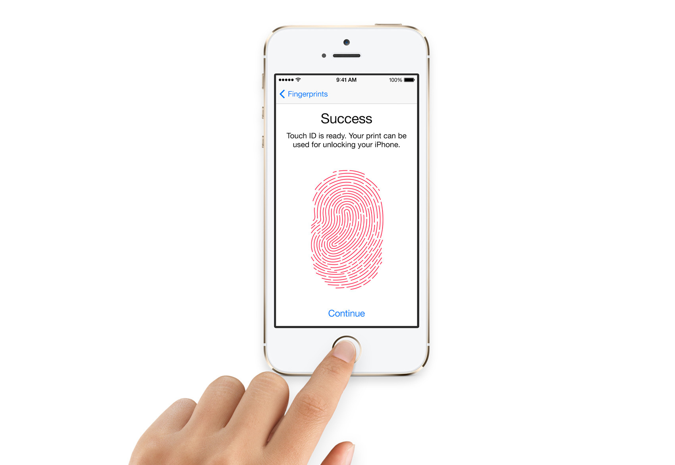
TOUCH ID
A thumbprint sensor embedded in the Home button lets you secure access to your device with your biometric data. It can also be used to authorize purchases and to unlock apps.

Slide 12
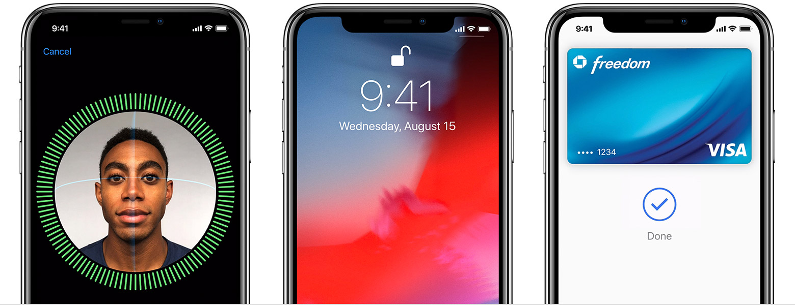
Face id
Introduced with the iPhone X, Face ID uses a complex system to identify a person's face to provide secure authentication to both the device and to services including Apple Pay.

Slide 13
HARDWARE SENSORS
Although they're not generally thought of explicitly as sensors, the cameras and microphones embedded in the iPhone, iPad, and iPod touch devices are, functionally, sensors. So are the Wi-Fi and cellular radios in the devices. That said, most device manufacturers consider their radios and cameras to be separate from sensors when listing them in tech specs and device manuals.

